Slide 1
Storing User Data
Building Personal Websites
Lecture 11 | Storing User Data

Slide 2
Session Storage Overview
Accessing Stored Values Between Pages
Building Personal Websites
Lecture 11 | Storing User Data

Slide 3
Store item click-count with value 0
sessionStorage.setItem(”click-count”, 0)
Retrieve item click-count
sessionStorage.getItem(”click-count")
Check item click-count is set
sessionStorage.getItem(”click-count") != null
Clear item click-count
sessionStorage.removeItem(”click-count")
Building Personal Websites
Lecture 11 | Storing User Data

Slide 4
What is sessionStorage?
A simple way of storing values in JavaScript for repetitive use.
Optimal use is when wanting to share values between pages.
Why can’t I use a global variable instead?
Global variables are reset each time the page is reloaded.
sessionStorage values are saved in the browser’s cache and are not cleared until either:
The browser’s cache is cleared
The browser is closed.
Building Personal Websites
Lecture 11 | Storing User Data

Slide 5
$(‘body’).click( function () {
if ( sessionStorage.getItem(”click-count”) != null ) {
var count = sessionStorage.getItem(”click-count”);
sessionStorage.setItem(”click-count”, count++);
}
else {
sessionStorage.setItem(“click-count”, 0);
}
});
Building Personal Websites
Lecture 11 | Storing User Data

Slide 6
Session Storage Overview
Accessing Stored Values Between Pages
Building Personal Websites
Lecture 11 | Storing User Data

Slide 7
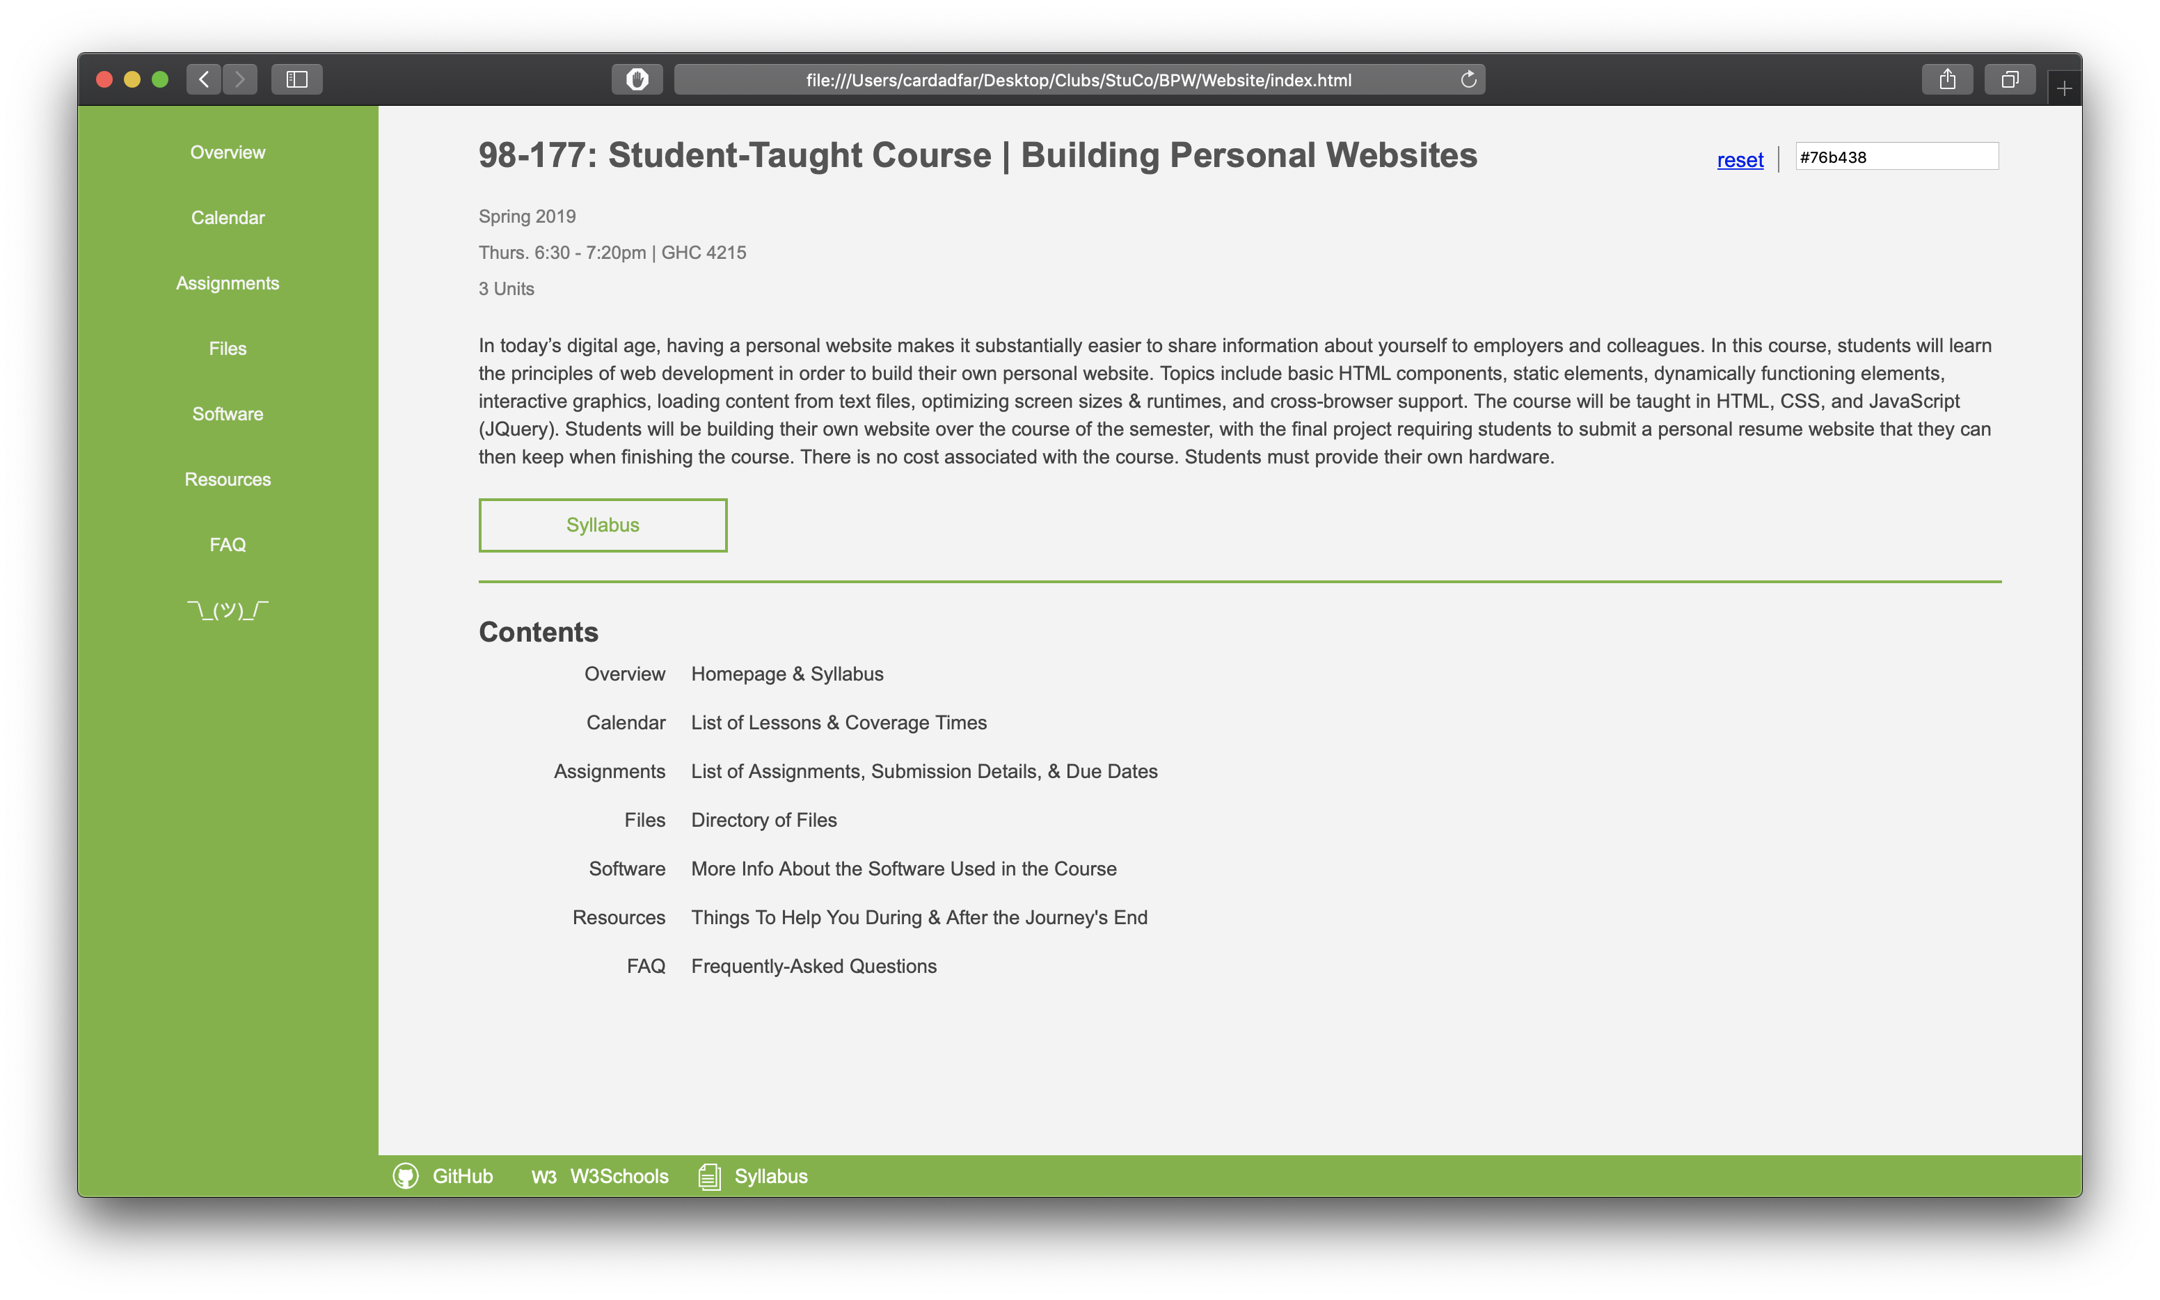
Color Storage
Building Personal Websites
Lecture 11 | Storing User Data

Slide 8
Instantiate Variables
Set sessionStorage
Create Color Selector on Statrtup
Update Color (Color Selector Event Handler)
Reset Color (Reset Button Event Handler)
Building Personal Websites
Lecture 11 | Storing User Data

Slide 9
If shared between HTML pages, each page can access bg_color variable
Building Personal Websites
Lecture 11 | Storing User Data

Slide 10
Live Demo
Building Personal Websites
Lecture 11 | Storing User Data

